Slide 1
Natural Resources of the Middle East
Bell Ringer:
What is the most abundant natural resource in the Middle East?
What is a scarce natural resource in the Middle East?

Slide 3
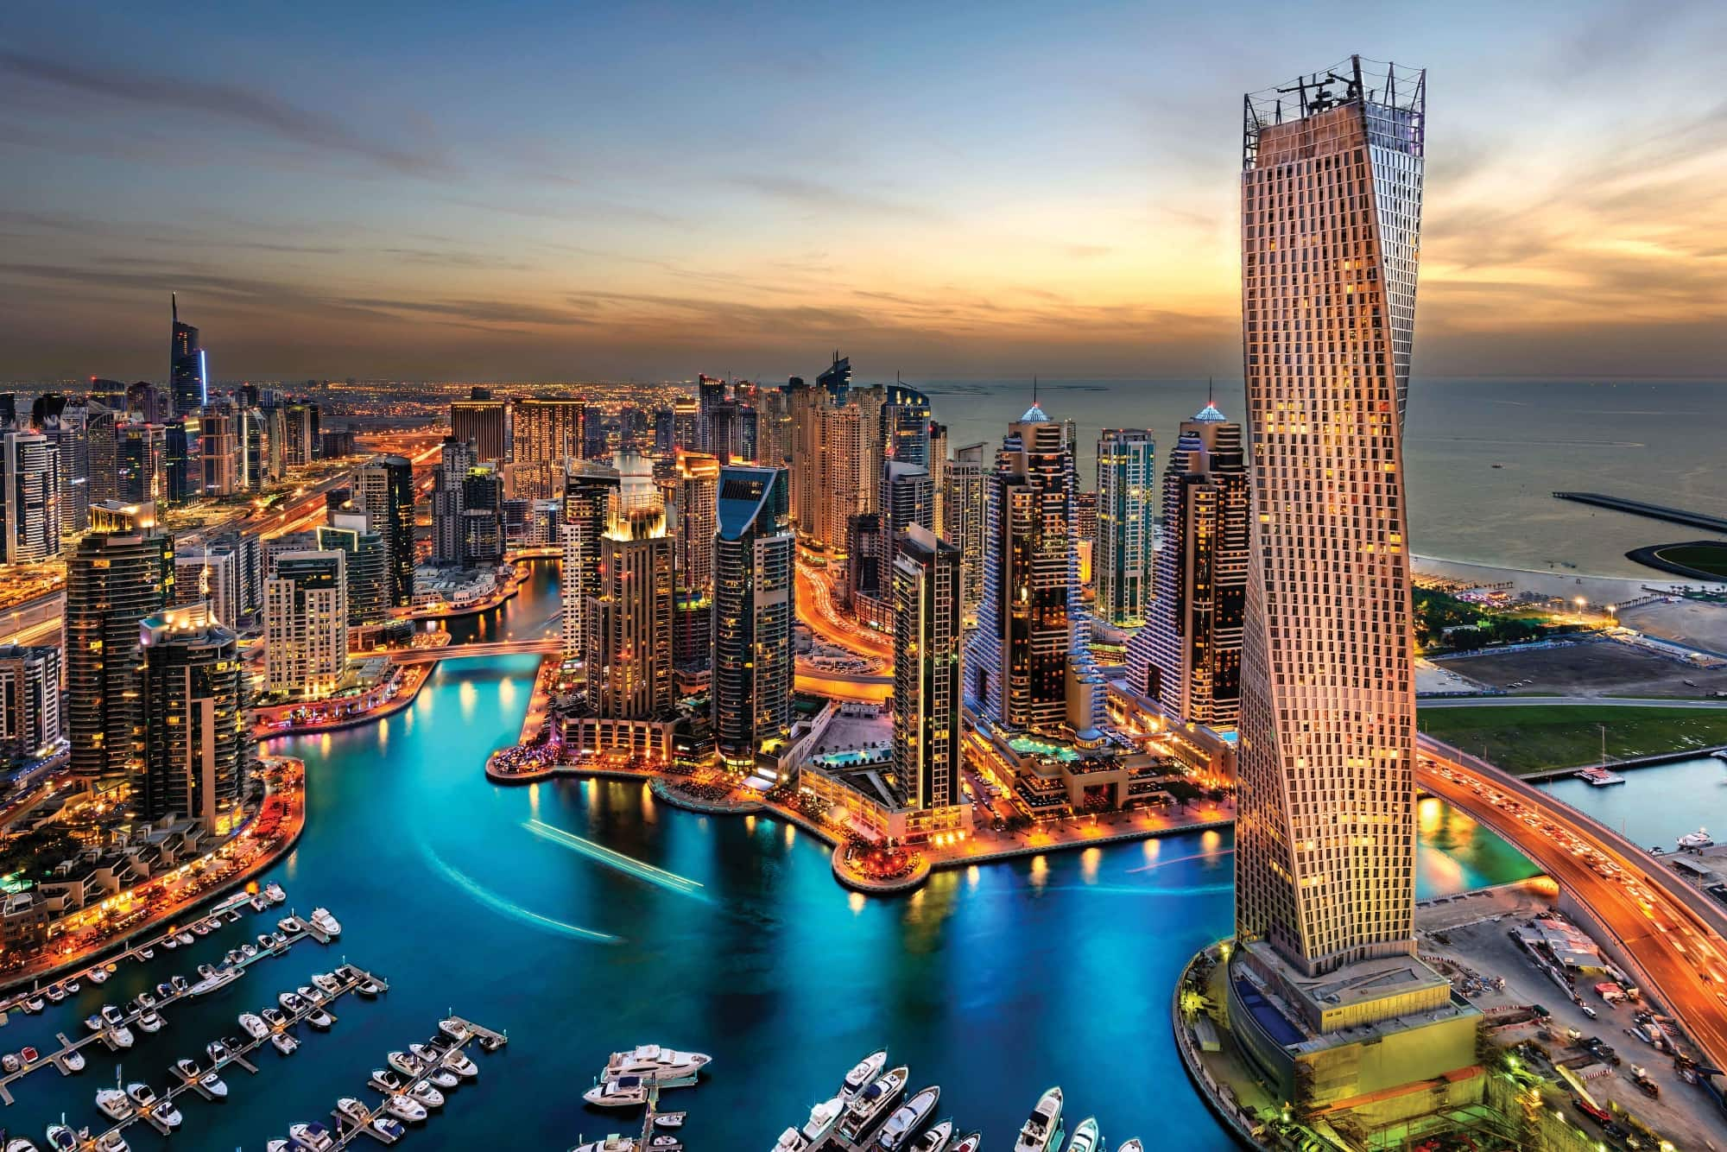

Slide 4
Oil
The Middle East holds the largest, proven oil reserves in the world along with large deposits of natural gas.
https://www.cia.gov/library/publications/the-world-factbook/rankorder/2241rank.html
Countries in the Middle East account for 5 of the top 15 oil producers in the world.

Slide 5
Crude Export and Import
http://www.worldmapper.org/display.php?selected=75
http://www.worldmapper.org/display.php?selected=76

Slide 6
Organization of Petroleum Exporting Countries (OPEC)
OPEC formed in 1960.
Group of 13 countries from the Middle East, Africa, and South America.
OPEC alone holds 80% of the worlds oil reserve.
65% of those reserves are in the Middle East
Influential in the world market of oil

Slide 8
Impact on the Region
Oil prices directly impact how well the countries in this region economically grow and develop
Around 2008 oil prices rose and huge developments began in Dubai, Oman, and Saudi Arabia
Dubai had projects worth $200 Billion

Slide 9
Impacts on the Region
Power shifts from society to state
If there is enough oil revenue, governments do not charge taxes
Governments do not listen to citizens because they do not collect taxes
Countries dependent on foreign countries `

Slide 10
Impacts on the Region
As prices rise, countries grow economically and the populations become wealthier
When prices drop, countries go into distress financially and conflict arises
Since the economy and political structure are so dependent on oil, it can be very unstable
Countries use oil as a weapon

Slide 11
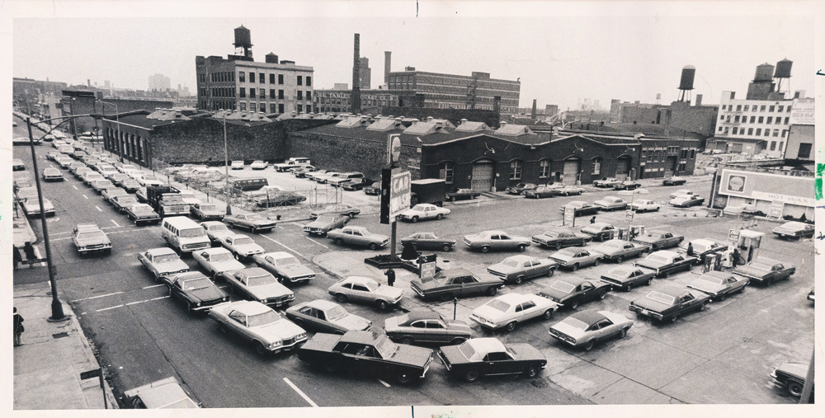

Slide 12
Annotation Directions
As you read, underline sentences you find interesting, surprising, or a passage you can make connections with. Both articles can be connected to North Dakota.
With each underline, write a brief explanation in the margin on why you underlined that sentence.

