Slide 1
Learning Preference Inventories

Slide 2
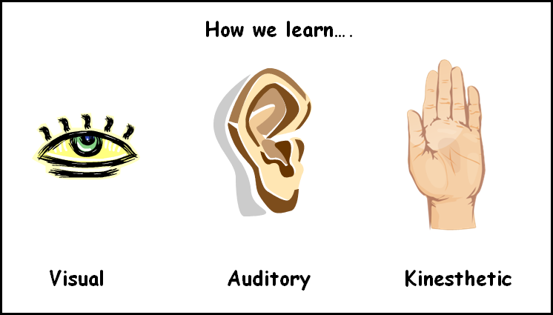
What is it?
Learning preference inventories determine how a student learns best
Usually a number of questions
4 Different Learning Styles
Auditory
Kinesthetic
Visual
Read/Write

Slide 3
How can it help you?
Knowing your learning style allows you to find strategies that will help you understand and learn more effectively
Can find study tips based on your learning style
Tips on how to understand information presented by teachers

Slide 4
How can it help me?
It gives me a better understanding on how my students learn best
I can adapt lessons to my students learning preferences
By changing the learning styles used I keep students engaged in lessons
More personal learning
Give students options of assignments to fit with their learning preference

Slide 5
Results from Inventory #1
The results will tell you if you are a visual, auditory, kinesthetic, read/write, or combined learner.
Below your learning preference will be strategies and tips for learning that coordinate with your learning style.
Read over these to see how you learn best.
Employ strategies that coordinate with your learning style.

Slide 6
Learning Inventory #1 What’s Your Learning Style? 20 Question
This inventory is a questionnaire of 20 questions that will determine if a student is a visual, auditory, kinesthetic, or read/write learner.
Follow these steps to find out YOUR learning style!
1.Go to http://www.educationplanner.org/students/self-assessments/learning-styles-quiz.shtml
2. Answer all 20 questions (hitting the back button will start the inventory over)
3.Results will show after all questions are answered

Slide 7
Gardner’s Multiple Intelligences
Similar to learning styles
8 Intelligences
Everyone is different
How students learn and understand information

Slide 8
Inventory #2 Multiple Intelligence Inventory Assessment: Find Your Strengths!
Here is how to find our YOURS!
This is a multiple intelligence inventory. It goes beyond the four basic learning styles to a more specific learning style.
1. Go to http://www.literacynet.org/mi/assessment/findyourstrengths.html
2. Answer the questions
3.Click Find My Strengths on the bottom of the page
4. Read through your results

Slide 9
Results for Inventory #2
This inventory determines your top 3 intelligences.
The intelligences are:
Spatial
Language
Body Movement
Self
Social
Musical
Logic/Math
Nature

Slide 10
Results from Inventory #2
The results will show your top 3 intelligences.
Although it shows your top 3, you may also be strong in any of the other 5.
Under your intelligence there will be an explanation of your intelligence and tips for how to learn best.

Slide 11
References
http://psychology.about.com/od/educationalpsychology/g/learning-style-inventory.htm
http://teach.com/what/teachers-teach/learning-styles
http://www.tecweb.org/styles/gardner.html

